Slide 1
BoardGameGeek Recommender System
By Ari Francisco

Slide 2

Purpose of The Recommender System
Predict ratings for unrated games
Recommend games based on user-specific predictions
Increase sales through more accurate recommendations
Increase click-throughs and website traffic
Increase ad revenue via increased traffic

Slide 3
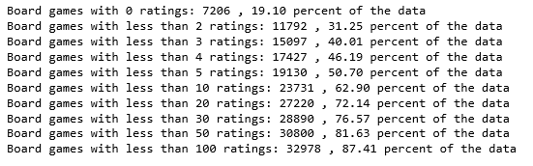
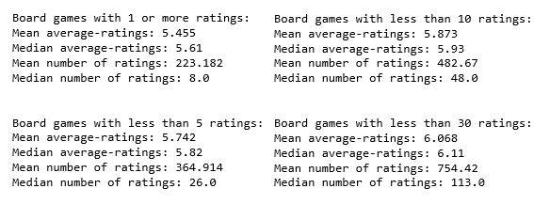
How Many Board Games Are Rated?
The mean and median of the average ratings are close for all four groups.
Therefore, it can be said that the dataset of board games with at least 30 ratings per game would reasonably reflect the games with fewer ratings.
50% of the games have less than 5 ratings
20% of the games don’t have any rating at all

Slide 4
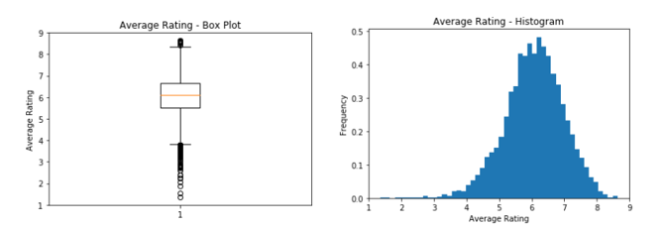
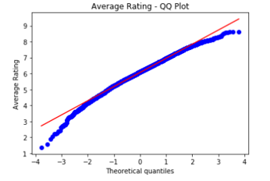
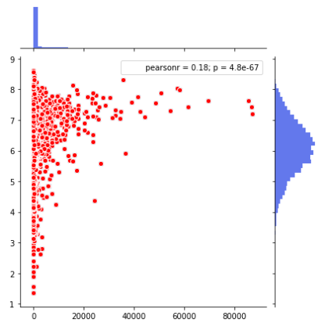
EDA on Games with More Than 30 Ratings
Boxplot shows that most ratings are between 3.5 – 8.5 with mean of around 6
Outliers are present, however
The histogram and QQ Plot illustrate that the dataset is normally distributed
The scatter plot shows the number of ratings vs the average rating of a board game
Games with a higher number of ratings tend to receive a higher average rating

Slide 5
Correlation Between Ratings and Categories
Positive Correlation
Negative Correlation
Wargame | 0.367
Hex-and-Counter | 0.278
World War I | 0.239
Simulation | 0.228
World War II | 0.215
Dice Rolling | 0.159
Miniatures | 0.148
Napoleonic | 0.133
Route/Network Building | 0.121
Area Control / Area Influence | 0.113
Civil War | 0.108
Campaign / Battle Card Driven | 0.105
Chit-Pull System | 0.100
Roll / Spin and Move | -0.279
Movies / TV / Radio theme | -0.181
Trivia | -0.160
Party Game | -0.123
Card Game | -0.115
Action / Dexterity | -0.104
Set Collection | -0.102
The strongest correlation either positive or negative is in the “Wargame” category

Slide 6
Is the “Wargame” to Higher-Rating Correlation Statistically Significant?
Category | Amount | Avg-Rating Mean | Avg-Rating Variance
Wargame | 2,412 | 6.6013 | .567
Not Wargame | 6,428 | 5.8673 | .731
t-statistic | 39.3026
p-value | 8.89E-294
Null-Hypothesis: The mean of the average ratings of board games in the wargame category is equal to that of the non-wargame category
Alt-Hypothesis: The mean of the two categories are not equal
Alpha: .05
The p-value of the two-sample t-test was far below .05
We reject the null hypothesis
There is evidence to suggest that board games in the “Wargame” category do indeed receive higher average ratings than board games that are not in the category

Slide 7
Preparing The Dataset
Username | Game_ID | Rating
MossGrande | 49454 | 3.0
crostino | 49454 | 3.0
wolfzell | 49454 | 2.0
scatman | 49454 | 2.0
Nicodemus42 | 49454 | 1.0
 | game 1 | game 2 | game3 | game 4 | game 5
user 1 | 8 |  |  | 4
user 2 |  | 7
user 3 | 6 |  | 5
user 4 |  |  |  | 6
user 5 |  | 2 |  |  | 3
The dataset consists of:
every username
every board game’s ID number
the rating given to that game by that user
The dataset* must be transposed into a matrix format
each row is a user
each column is a board game
the fields are filled with the user’s rating for that board game
* Due to the size of the dataset and computational limitations, a random sampling of 50,000 rows was used in the algorithm for the recommender system

Slide 8


Results
BaselineOnly model algorithm gives a random rating to the empty fields based on the distribution of the dataset (assumed to be normal)
RMSE of BaselineOnly model, 1.507441, used as standard to beat
Model-Based Approach: SVD
RMSE on the SVD Test set
Memory-Based Approach: KNNwithMeans
Grid search was performed to find the best parameters for the SVD model
A train-test-split analysis was conducted with best parameters
Training set RMSE beat the BaselineOnly model
The test set RMSE beat the BaselineOnly model
Grid search was performed to find the best parameters for the KNNwithMeans model
This model performs worse than the BaselineOnly model

Slide 9
Conclusion & Improvements to The Recommender System
The collaborative filtering method that provided the best results for the recommender system was the SVD algorithmusing more data
KNNWithMeans did not provide a better result than either of the SVD model or the BaselineOnly Model
The results of the algorithms can be improved greatly by using more data
Only 50,000 rows used
full dataset is over 6.6 million rows
More computing power is needed to be able to build a full recommender system on all the data that was scraped from BoardGameGeek’s API

